Slide 1

DEPARTMENT OF COMPUTER SCIENCE & ENGINEERING
SCHOOL OF COMPUTING
1156CS701- MAJOR PROJECT
WINTER SEMESTER 2022-2023
INTERNSHIP THROUGH DIND
BOSTON IT SOLUTIONS PVT LTD
SEMESTER END PROJECT VIVA VOCE EXAMINATIONS
“TWITTER DATA ANALYSIS USING NLP”
SUPERVISED BY
Faculty Name:Ms R.Vaishnavi
Designation:Associate Professor
PRESENTED BY
1. A.YASHWANTH SAI ( 13678)(19UECS0043)
2. M.PRAMODH KUMAR (13847)(19UECS0788)
3. B.AJAY KUMAR (15265)(19UECS0123)

Slide 2
INDUSTRY DETAILS
Industry Name/Institute Name:Boston IT Solution PVT LTD
Duration of Internship :(18/02/23 - 20/05/23)
Duration of Internship in Months:3 MONTHS
Industry Guide Name & Designation: Mr. Raakesh Kumar & (Junior Data Analyst)

Slide 3
AGENDA
ABSTRACT
OBJECTIVE
INTRODUCTION
LITERATURE REVIEW (SOFT COPY OF PAPERS TO BE LINKED AS HYPERLINK)
DESIGN AND METHODOLOGIES
STANDARDS & POLICIES USED
IMPLEMENTATION
TESTING
INPUT AND OUTPUT
INCLUDE DEMO VIDEO (You Tube URL of complete demonstration of project )
CONCLUSION
FUTURE ENHANCEMENTS
WEB REFERENCES LINK
REFERENCES
PLAGIARISM REPORT OF PPT
INCLUDE YOUR 2 PHOTOS OF YOUR INDUSTRY WORKING ENVIRONMENT
INTERNSHIP CERTIFICATE (Offer Letter and Completion certificate)
POSTER PRESENTATION
JOURNAL/CONFERENCE PUBLICATION PROOF(MANDATORY TO ATTACH)

Slide 4
ABSTRACT
This project main aim to perform Twitter data analysis using Natural Language Processing (NLP) techniques. The dataset consists of tweets related to a particular topic collected from Twitter’s API. The tweets are preprocessed, including removing stop words, stemming, and lemmatization. The sentiment analysis is performed to identify the polarity of the tweets, the most frequent words ,hashtags are extracted. Furthermore, topic modeling is performed using Latent Dirichlet Allocation (LDA) to discover the underlying topics in tweets. Finally, the results are visualized using various graphs, charts, providing insights into people’s opinions and discussions on the particular topic on Twitter.

Slide 5
OBJECTIVES
Aim of the project:
The goal of this project is to employ natural language processing methods to examine Twitter data in order to better understand user behaviour and sentiment. The end objective is to give useful information that can be used by businesses and other organisations to make informed decisions based on Twitter data.
Scope of the project:
Preprocessing, feature extraction, and machine learning models will all play roles in the analysis of a sizable dataset of tweets. Market research, opinion mining, and social media monitoring are just some of the many potential uses for the data uncovered by the analysis.

Slide 6
INTRODUCTION
Twitter and other social media sites have rapidly gained popularity as information resources for both people and established businesses. There is a rising need for methods to mine the wealth of information posted on Twitter for useful insights. Sentiment analysis, topic modelling, and opinion mining are just a few examples of the types of Natural Language Processing (NLP) techniques that may be used to analyze Twitter data and derive useful insights. In this paper, we will look into how natural language processing (NLP) methods may be used to Twitter data in order to discover new patterns and insights.

Slide 7
LITERATURE REVIEW
[1] As time goes on, social media like Facebook, Twitter, Instagram, etc., become increasingly important information resources. It has been determined that a company can gain in terms of product marketing from the extraction and analysis of data from social networking sites. You may find a lot of people's opinions and experiences with a product on Twitter, making it a popular platform for user-generated content. To do this, we collect and analyze tweets on a product's performance. To start, we have created a framework for filtering tweets based on pre-processed data that is powered by natural language processing (NLP). To further assess sentiment, we use the Bag of Words (BoW) and Term Frequency-Inverse Document Frequency (TF-IDF) model concepts. An effort is in way to use BoW and TFIDF together to accurately categorize tweets as either positive or negative. Simulation results demonstrate the efficacy of our proposed system, and we find that the accuracy of sentiment analysis may be significantly increased by utilizing the TF-IDF vectorizer. Our NLP-based sentiment analysis was 85.25 percent accurate.

Slide 8
LITERATURE REVIEW
[2] User-generated content is abundant on the social media. The opinions expressed on social media need to be categorized and organized, hence an automated method is required. The proposed framework employs an Artificial Recurrent Neural Network (ARNN) equipped with bi-directional long short-term memory (LSTM) to categorize emotions. This diagram illustrates the structure of an RNN equipped with a two-way LSTM. A bidirectional LSTM model was applied to the Twitter sentiment dataset on US airlines. This experiment uses texts of varied lengths. In this study, we give a graphical illustration of the analysis. The answer may be seen in the confusion matrix. At the end of the day, it all boils down to a simple analysis and classification of positive, negative, and neutral feelings.

Slide 9
LITERATURE REVIEW
[3] It's crucial to study the effects of sentiment analysis (SA) on social media. Information, whether it be facts or opinions, that are widely shared on Twitter eventually makes their way to other users. Researchers have found Twitter to be difficult due to the shorter messages and the ever-evolving online vernacular. In this research, we suggest utilizing BERT to create a model for sentiment analysis. This study optimizes BERT for the SA problem by adding an extra layer on top. By following certain basic guidelines, a fully connected neural network may achieve state-of-the-art outcomes and be readily fine-tuned for such a downstream purpose. A small number of feature sets are tested after the suggested approach is implemented. The model demonstrated that stop-word usage within the dataset does impede the classifier's performance, and that dividing up the tweets into positive and negative examples to extract subjects and keywords yields better results than merging the two. The impact on model performance of selecting k random topics from a pool of t topics was also demonstrated experimentally.

Slide 10
LITERATURE REVIEW
[4] Countless individuals daily use social networking platforms like Twitter to express themselves through tweets. Due to the nature of the medium, tweets tend to be succinct and straightforward. As a result, the subject of this literature review is Twitter data sentiment analysis. Sentiment analysis is a subfield of text data mining and natural language processing. Sentiment analysis using Twitter data may be studied from several angles. The purpose of this article is to demonstrate the many forms and methods of sentiment analysis that can be used to extract sentiment from Twitter posts. Using Twitter as a data source, we conducted a poll comparing several sentiment analysis methods.

Slide 11
LITERATURE REVIEW
[5] The bag-of-words method is often used by sentiment analysis algorithms to extract opinions from textual sources like user reviews and social media posts. The bag-of-words method uses word frequency and count as feature vectors rather than the entire phrase or paragraph. When used to tasks like sentiment classification, this may confuse the classification system. Naive Bayes, Maximum Entropy, Support Vector Machines, etc., are some of the most common classical machine learning algorithms used for classification issue solving. Unfortunately, class bias is common in machine learning algorithms. In this research, we present an NLP-based technique to improve sentiment classification by the incorporation of semantics in feature vectors and the subsequent use of ensemble methods for classification. Improve prediction precision by include context-sense identities and semantically related terms in feature vectors. Experimental results show that the semantics-based feature vector with ensemble classifier achieves 3-5% higher accuracy than the standard bag-of-words method using a single machine learning classifier.

Slide 12
LITERATURE REVIEW
[6] The feelings of WEB users have a great influence on rest of the users, product sellers and market analysis. It is necessary to well structure the unstructured data from various social platforms for proper and meaningful analyses. For the classification of multilingual data, the analysis of feelings has recognized significant attention. This is called textual organization that may be used to classify state of mind or feelings expressed in different ways like: negative, positive, favorable, unfavorable, thumbs up, thumbs down, etc. in the field of Automatic Language Processing (NLP). To solve this kind of problem, sentiment analysis and deep learning techniques are two merging techniques. Because of machine learning ability, deep learning models are effectively used for this purpose. Recurrent Neural Networks (RNN) and Naive Bayes algorithm are two popular deep learning architectures to analyze feelings in sentences. These architectures may be used in natural language processing. In this research article, we propose solutions to multilingual sentiment analysis problem by implementing algorithms and in order to contract the result, we compare precision factor to find the best solution for multilingual sentimental analysis

Slide 13
LITERATURE REVIEW
[7] In order to better understand the tone of tweets on charitable giving, the authors plan to employ sentiment analysis. In the context of exploratory data analysis, this study discusses methods for capturing people's positive and negative feelings regarding making charitable contributions. The authors use the NLTK library from the Natural Language Processing project to figure out if a tweet is good, negative, or ambivalent. They have collect potential customers by analyzing tweets about donations and using that information as a training dataset.

Slide 14
LITERATURE REVIEW
[8] By our constant connection to the web, social media have become an essential part of our daily life. Sentiment analysis is the act of recognizing and evaluating a piece of text to determine if its sentiment, ideas, perspectives, and feelings are good, negative, or neutral towards a certain problem, object, etc. using the Natural Language Tool Kit (NLTK). Social media has become indispensable to modern communication. Twitter, a popular social media and news sharing platform, allows its users to express their political beliefs. Short messages and comments can be left by users. A company may monitor its reputation on the social networking site Twitter by looking at the words people use to describe it. There are a wide variety of approaches to sentiment analysis since it has so many potential uses. Opinion analysis may be done in one of two major ways: with a knowledge base or with machine learning. Voting system tags were used to collect Twitter data for this investigation. Pre-processing of Tweets involved the use of text mining. Inverse document and phrase frequencies were used to build a vector space model, which was then used to do sentiment analysis using the Random Forest Classifier, the Decision Tree Classifier, and the Logistic Regression techniques. Discussion of experiments and inferences derived

Slide 15
LITERATURE REVIEW
[9] In today's rapidly expanding global community, Social Sites serve as a hub for countless people's daily interactions. Everyone had at least one connection to the social networks. It's clear that people are accustomed to reading evaluations before undertaking any activity, whether it's going to the movies, eating at a restaurant, buying a product online, or any number of other activities. Reviewing products entails familiarity with user feedback. Sentiment analysis, opinion mining, and data mining are various names for the same thing. The current study introduces the concept of Twitter Sentiment Analysis, a method developed to learn what a user was feeling at the time of composing a tweet. Everyone can get a conclusion about a topic after learning what other people think about it. In the current work, Natural Language Processing (NLP) is used to do this kind of analysis. In light of this, the methods employed and steps taken will be detailed in this study report.

Slide 16
LITERATURE REVIEW
[10] In today's times, people are paying a lot more attention to social media than ever before because of how easy it is to access. Wherein one's freedom to freely communicate any and all political, emotional, and intellectual opinions can be reflected in a single tweet, regardless of the impression it may have on the minds of the general public. These days, young people may communicate with the outside world through social media without necessarily considering the repercussions. As a result, there may be both benefits and drawbacks. One such platform is Twitter, where users express themselves through short messages known as "Tweets." There are three broad categories for interpreting the tone of tweets: positive, negative, and neutral. As a result, our model considers the sentiment analysis performed with Natural Language Processing and other Machine Learning classifiers. In this work, we have compared many ML classifiers by making use of the dynamic dataset, which is a new and exciting development in the field.

Slide 17
DESIGN AND METHODOLOGIES
MODULE 1: Data Collection and Preprocessing
MODULE 2: Natural Language Processing (NLP) Analysis
MODULE 3: Visualization and Reporting

Slide 18
MODULE:1
Data Collection and Preprocessing:
This section covers the steps involved in gathering Twitter data through the Twitter API or external tools, cleaning the data by removing noise, irrelevant information, and duplicates, and preprocessing the data for analysis through natural language processing techniques such as tokenization, stop-word removal, and stemming.

Slide 19
MODULE:2
Natural Language Processing (NLP) Analysis:
This section employs natural language processing strategies including topic modelling, named entity identification, and sentiment analysis on the cleaned Twitter data to draw conclusions. Construction and training of machine learning models, such as classification, clustering, and regression models, for predicting or categorizing tweets based on specified criteria may also be a part of this module.

Slide 20
MODULE:3
Visualization and Reporting:
At this stage, we'll use word clouds, graphs, and charts to visualize the NLP analysis's findings and draw conclusions about Twitter's data. Also, this section includes the creation of reports or dashboards that summarize the analysis's results and insights for stakeholders to utilize in making educated decisions or taking the necessary steps.

Slide 21
STANDARDS & POLICIES
Python Standard Used: ISO/IEC WD TR 24772-4
Anaconda-Standard Used: ISO/IEC 10918-1:1994

Slide 22
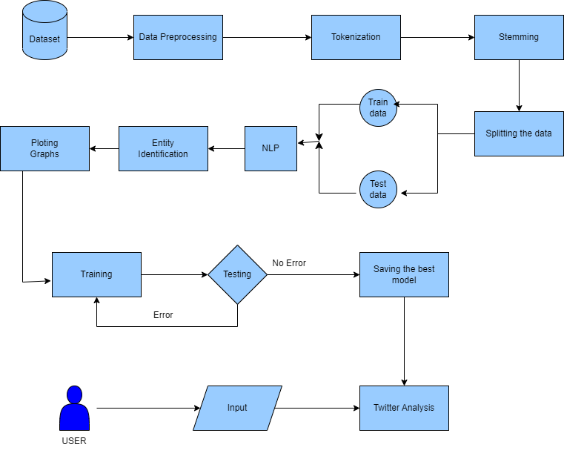
IMPLEMENTATION
Architecture Diagram

Slide 23
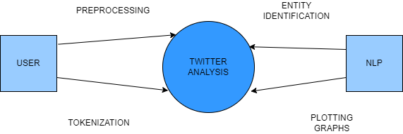
IMPLEMENTATION
Data –Flow Diagram

Slide 24
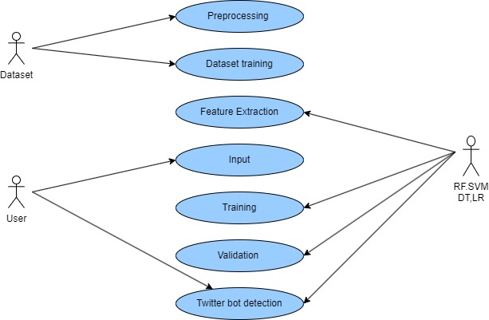
IMPLEMENTATION
Use Case Diagram

Slide 25
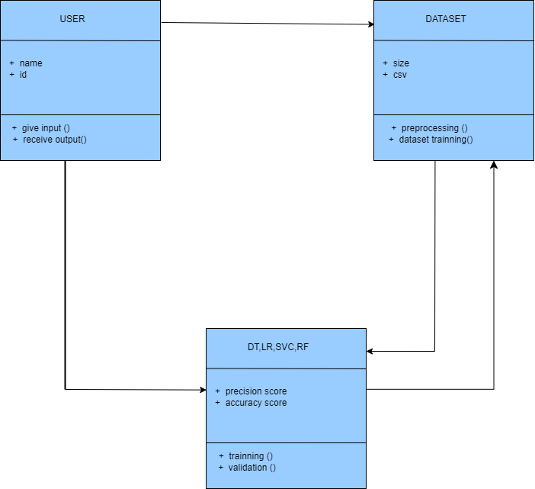
IMPLEMENTATION
Class Diagram

Slide 26
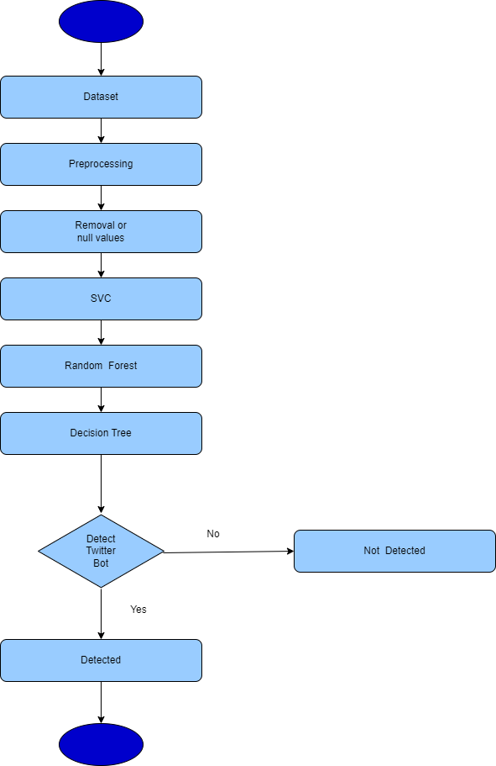
IMPLEMENTATION
Activity Diagram

Slide 27
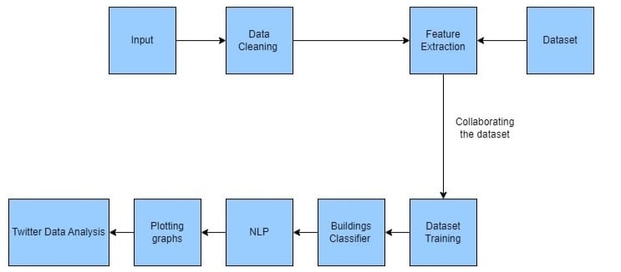
IMPLEMENTATION
Collaboration Diagram

Slide 28
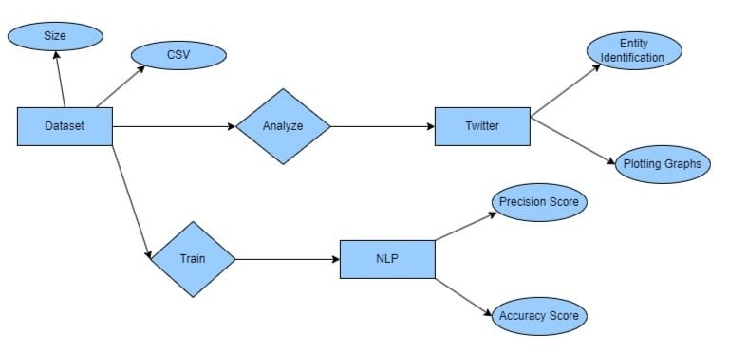
IMPLEMENTATION
E-R Diagram

Slide 29
TESTING
UNIT TESTING
Test Cases
Test that the NLP pipeline is correctly preprocessing the Twitter data, including removing URLs, mentions, and hashtags, tokenizing the text, and converting everything to lowercase.
Test that the sentiment analysis model is correctly classifying tweets as graphs.
Test that the named entity recognition model is correctly identifying named entities such as people, organizations, and locations.

Slide 30
TESTING
INTEGRATION TESTING
Test Cases
Test that the data is correctly fetched from Twitter's API and that the relevant parameters are correctly set for filtering the tweets.
Test that the NLP preprocessing pipeline is integrated correctly with the data retrieval process, such that the fetched tweets are preprocessed before analysis.
Test that the sentiment analysis model is integrated correctly with the preprocessed data, such that sentiment scores are correctly assigned to each tweet.

Slide 31
TESTING
FUNCTIONAL TESTING
Test Cases
Test that the Twitter data analysis system is able to handle a large volume of tweets without crashing or experiencing performance issues.
Test that the sentiment analysis model is able to correctly classify a diverse range of tweets, including those with sarcasm or other nuances that may affect sentiment.
Test that the named entity recognition model is able to correctly identify a wide range of named entities, including those that may not be commonly found in the English language.

Slide 32
TESTING
WHITE BOX TESTING
Test Cases
Test that the code for the NLP preprocessing pipeline is correctly tokenizing the text and removing irrelevant information, such as URLs and punctuation.
Test that the code for the sentiment analysis model is correctly implementing the chosen algorithm and that it is accurately classifying tweets.
Test that the code for the named entity recognition model is correctly implementing the chosen algorithm and that it is accurately identifying named entities.

Slide 33
TESTING
BLACK BOX TESTING
Test Cases
Test that the Twitter data analysis system is able to correctly retrieve and preprocess data from the Twitter API.
Test that the sentiment analysis model is accurately classifying tweets based on their sentiment, without being influenced by factors such as tweet length or specific keywords.
Test that the named entity recognition model is accurately identifying named entities in tweets, regardless of their specific context or language usage.

Slide 34
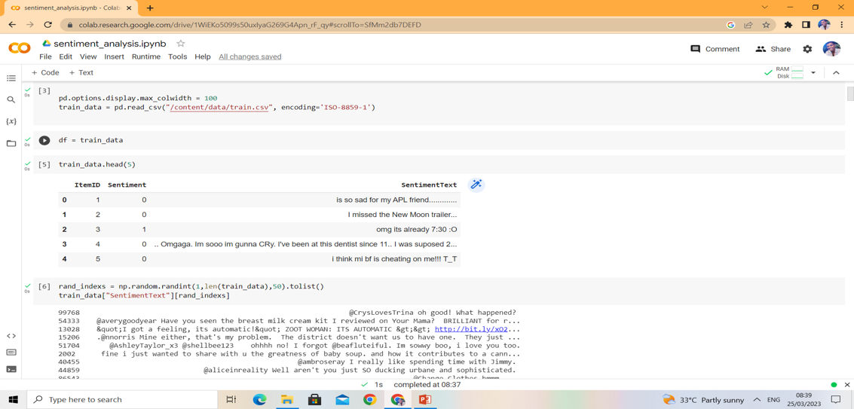
INPUT AND OUTPUT
INPUT

Slide 35
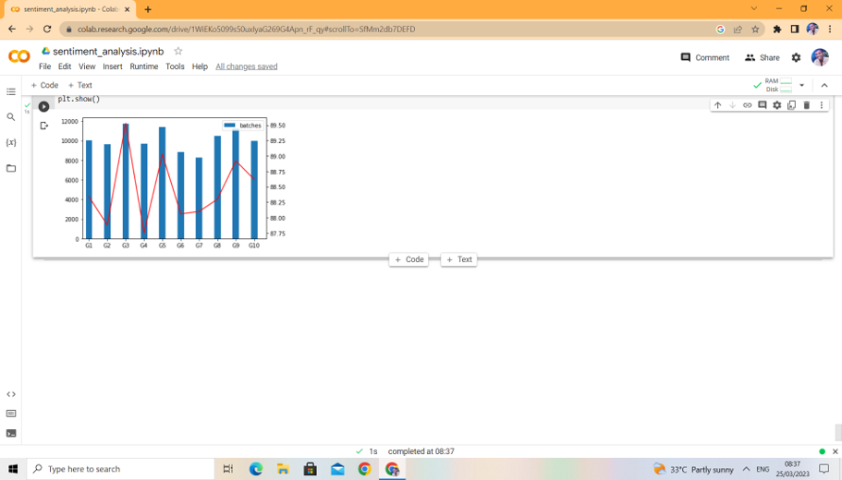
OUTPUT

Slide 36
https://youtu.be/7wc6XgTdYvg
DEMO VIDEO

Slide 37
CONCLUSION
Finally, our program shows how well natural language processing tools work for mining massive amounts of Twitter data. Sentiment analysis and topic modelling are just two examples of how we preprocessed the data and put natural language processing (NLP) algorithms to use to glean useful insights and patterns. The ramifications of these results for corporations, marketers, and legislators who are interested in gauging public opinion and behaviour on social media are substantial. To further enhance the precision and efficacy of Twitter data analysis, we advocate for the investigation of cutting-edge NLP methods and deep learning models.

Slide 38
Future Enhancements
Deep Learning Techniques: The integration of deep learning techniques, such as neural networks, can improve the accuracy and efficiency of sentiment analysis, topic modeling, and other text analysis tasks.
Multi-Lingual Support: Adding support for multiple languages can enable users to analyze the tweets in different languages, providing a more comprehensive under standing of people’s opinions and preferences across different regions and cultures.
Social Network Analysis: Incorporating social network analysis techniques can provides insights into the relationships and interactions between the users on the Twitter, enabling businesses and organizations to identify influencers and build the effective social media marketing strategies.
Real-time Analysis: Implementing real-time analysis capabilities that can enable businesses and organizations to monitor social media activity in real-time, allowing them to respond quickly to changes in the public opinion and adapt their strategies accordingly.

Slide 39
Web references/video links
[1]https://www.analyticsvidhya.com/blog/2021/06/twitter-sentiment-analysis-a-nlp-use-case-for-beginners/
[2]https://towardsdatascience.com/twitter-sentiment-analysis-classification-using-nltk-python-fa912578614c
[3]https://ieeexplore.ieee.org/abstract/document/9036670

Slide 40
REFERENCES
[1] M. R. Hasan, M. Maliha and M. Arifuzzaman, ”Sentiment Analysis with NLP on Twitter Data,” (2019) International Conference on Computer,, Chemical, Materials and Electronic Engineering (IC4ME2), Rajshahi, Bangladesh, 2019, pp. 1-4, doi: 10.1109/IC4ME247184.2019.9036670.
[2] S. Chaurasia, S. Sherekar and V. Thakare, ”Twitter Sentiment Analysis using Natural Language Processing,” (2021) International Conference on Intelligence and Computing Applications (ICCICA), Nagpur, India, 2021, pp. 1-5, doi: 10.1109/ICCICA52458.2021.9697136.
[3] A. Samir, S.M.Elkaffas and M. M. Madbouly,”Twitter Sentiment Analysis Using BERT,” (2021) 31st International Conference on Computer Theory and Applications (ICCTA), Alexandria, Egypt, (2021), pp. 182-186, doi: 10.1109/ICCTA54562.2021.9916614.

Slide 41
REFERENCES
[4] R. Wagh and P. Punde, ”Survey on Sentiment Analysis using Twitter Dataset,” (2018) Second International Conference on Electronics, Communication and Aerospace Technology (ICECA), Coimbatore, India, 2018, pp. 208-211, doi: 10.1109/ICECA.2018.8474783.
[5] M. Kanakaraj and R. M. R. Guddeti, ”NLP based sentiment analysis on Twitter data using ensemble classifiers,” (2015) 3rd International Conference on Signal Processing, Communication and Networking (ICSCN), Chennai, India, 2015, pp. 1-5, doi: 10.1109/ICSCN.2015.7219856.
[6] V. Goel, A. K. Gupta and N. Kumar, ”Sentiment Analysis of Multilingual Twitter Data using Natural Language Processing,” (2018) 8th International Conference on Communication Systems and Network Technologies (CSNT), Bhopal, India, 2018, pp. 208-212, doi: 10.1109/CSNT.2018.8820254.

Slide 42
REFERENCES
[7] A. Shelar and C. -Y. Huang, ”Sentiment Analysis of Twitter Data,” (2018) International Conference onScience and Computational Intelligence (CSCI), Las Vegas, NV, USA, 2018, pp. 1301-1302, doi: 10.1109/CSCI46756.2018.00252.
[8] M. Kavitha, B. B. Naib, B. Mallikarjuna, R. Kavitha and R. Srinivasan, ”Sentiment Analysis using NLP and Machine Learning Techniques on Social Media Data,” (2022)2nd International Conference on Advance Computing and Innovative Technologies in Engineering (ICACITE), Greater Noida, India, 2022, pp. 112-115, doi: 10.1109/ICACITE53722.2022.9823708.
[9] S. Tiwari, A. Verma, P. Garg and D. Bansal, ”Social Media Sentiment Analysis On Twitter Datasets,”(2020) 6th International Conference on Computing and Communication Systems (ICACCS), Coimbatore, India, 2020, pp. 925-927, doi: 10.1109/ICACCS48705.2020.9074208.

Slide 43
REFERENCES
[10] M. Wadera, M.Mathur and D. K.Vishwakarma, ”Sentiment Analysis of the Tweets- A Comparison of Classifiers on the Live Stream of Twitter, ” (2020) 4th International Conference on Intelligent Computing and the Control Systems (ICICCS), Madurai, India, 2020, pp. 968-972, doi: 10.1109/ICI CCS48265.2020.9121166.

Slide 44
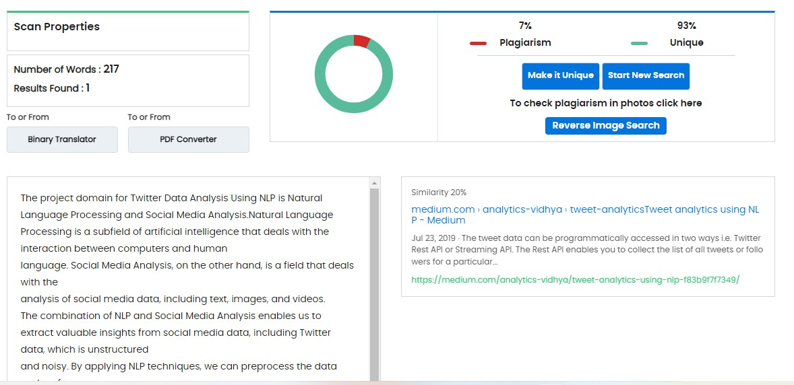
Plagiarism Report of PPT

Slide 45
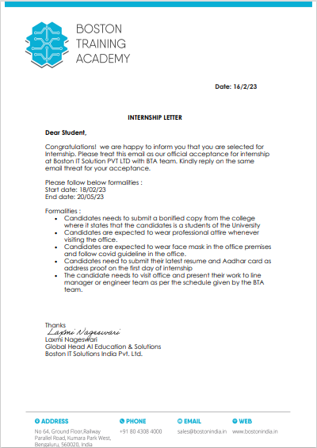
Internship Certificate
Offer letter

Slide 46
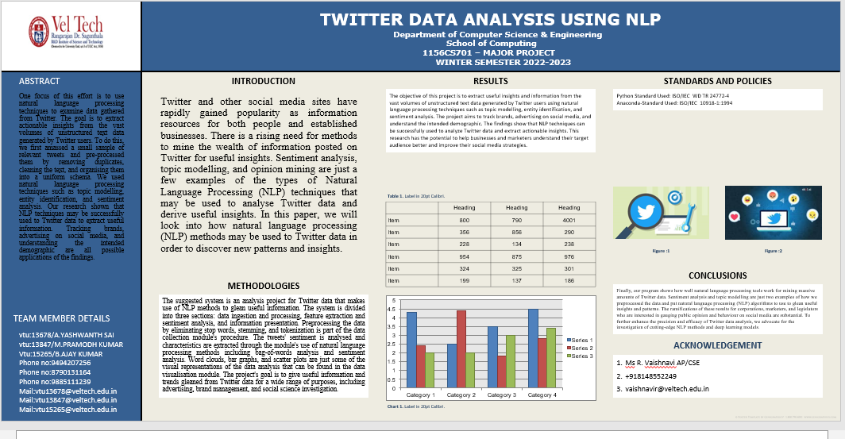
Poster Presentation

Slide 47
THANK YOU

